Slide 1
WALKING FOOTBALL IN THE COMMUNITY

Slide 2
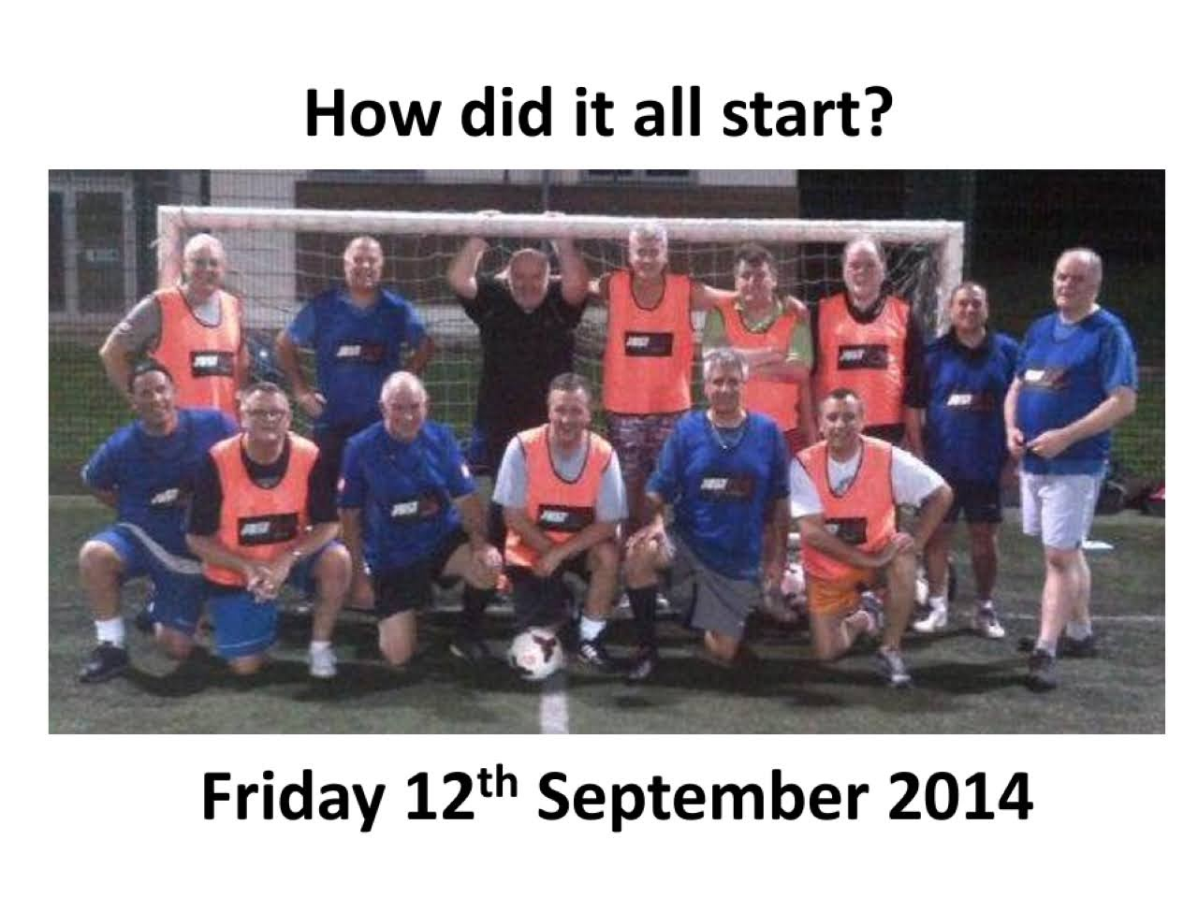
Sport for the over 50s
London’s first independent FA recognised WalkingFootball Club
Partnership with Middx FA
FA walking football strategy.
Recreational and competitive walking football.

Slide 3
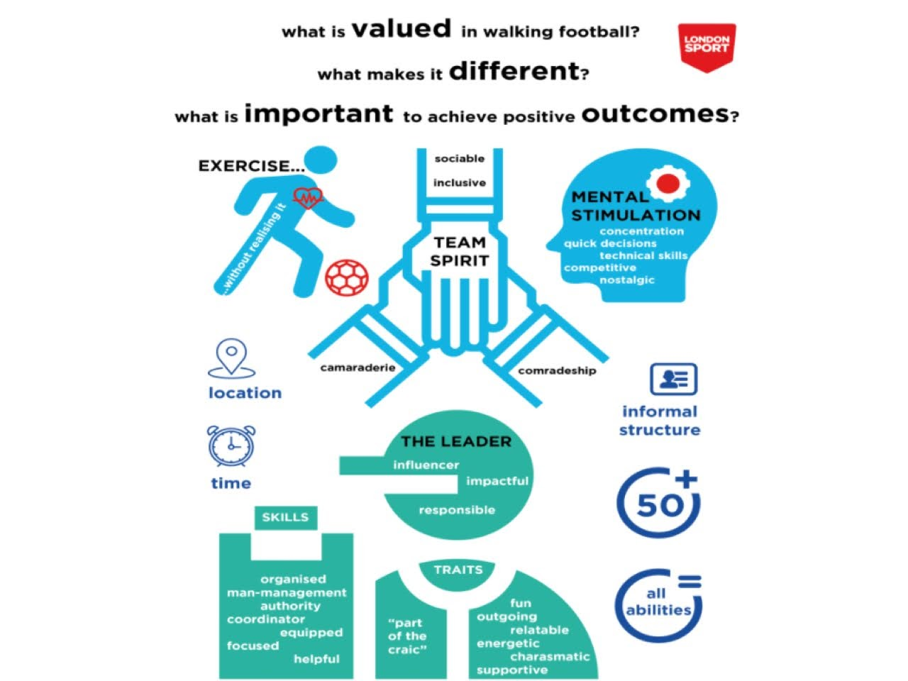
WHY WE PLAY
EXERCISE
SOCIAL
FRIENDSHIPS
NOSTALGIC
BANTER
FUN

Slide 4
SILVER FOXES IN THE COMMUNITY
Raising funds whilst having fun .
Social calendar, grants, donations and volunteering = £24k raised
7 years of working with key partners;
Hillingdon Council
Middx FA
Golf Trust
Harlington Hospice
QPR
HBTG
DASH

Slide 5
Dementia Friends of Hillingdon
Supporting the LBH Dementia Friends project since 2015.
Alzheimer’s Dementia Friends Champion.
Seated exercise classes.
Reminiscence sessions.
Walking Football
Golf
Tennis
Boccia

Slide 6
Living Well with Dementia

Slide 7
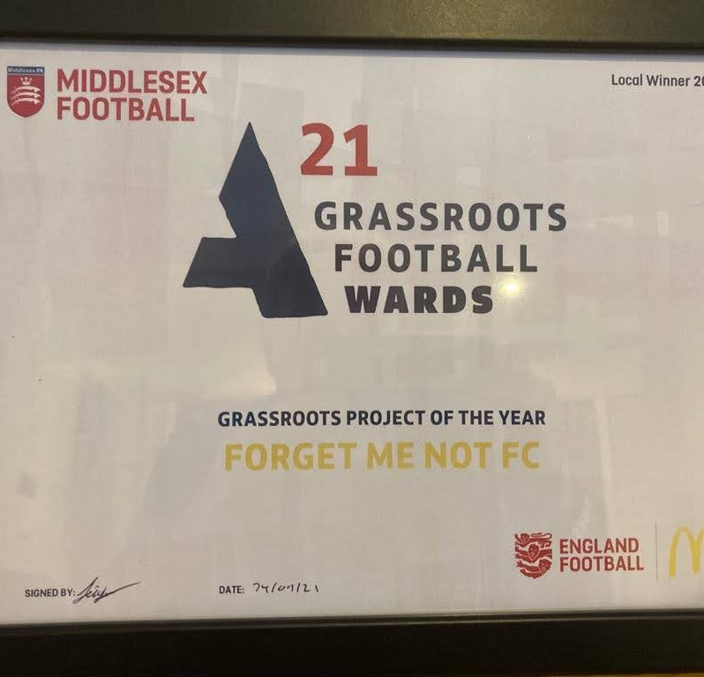
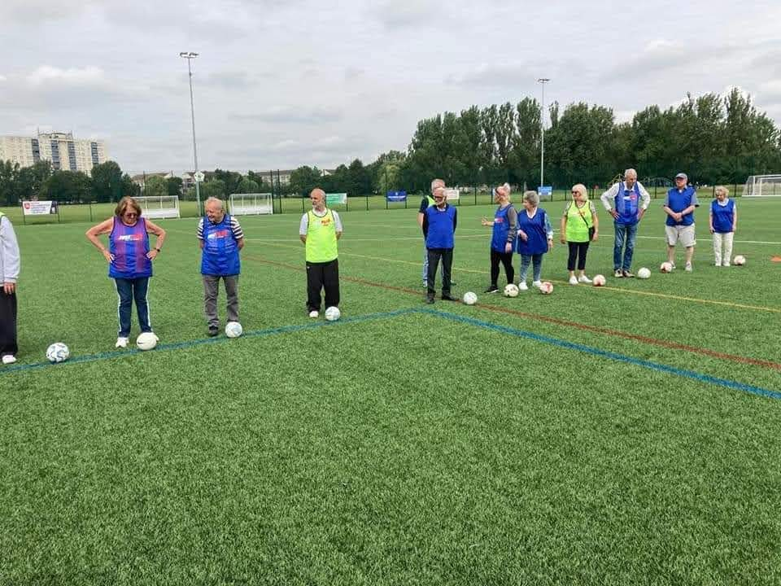
FORGET ME NOT FC
Weekly activity sessions .
30 participants.
Social
Exercise
Networking
LBH and Middx FA partners.

Slide 8
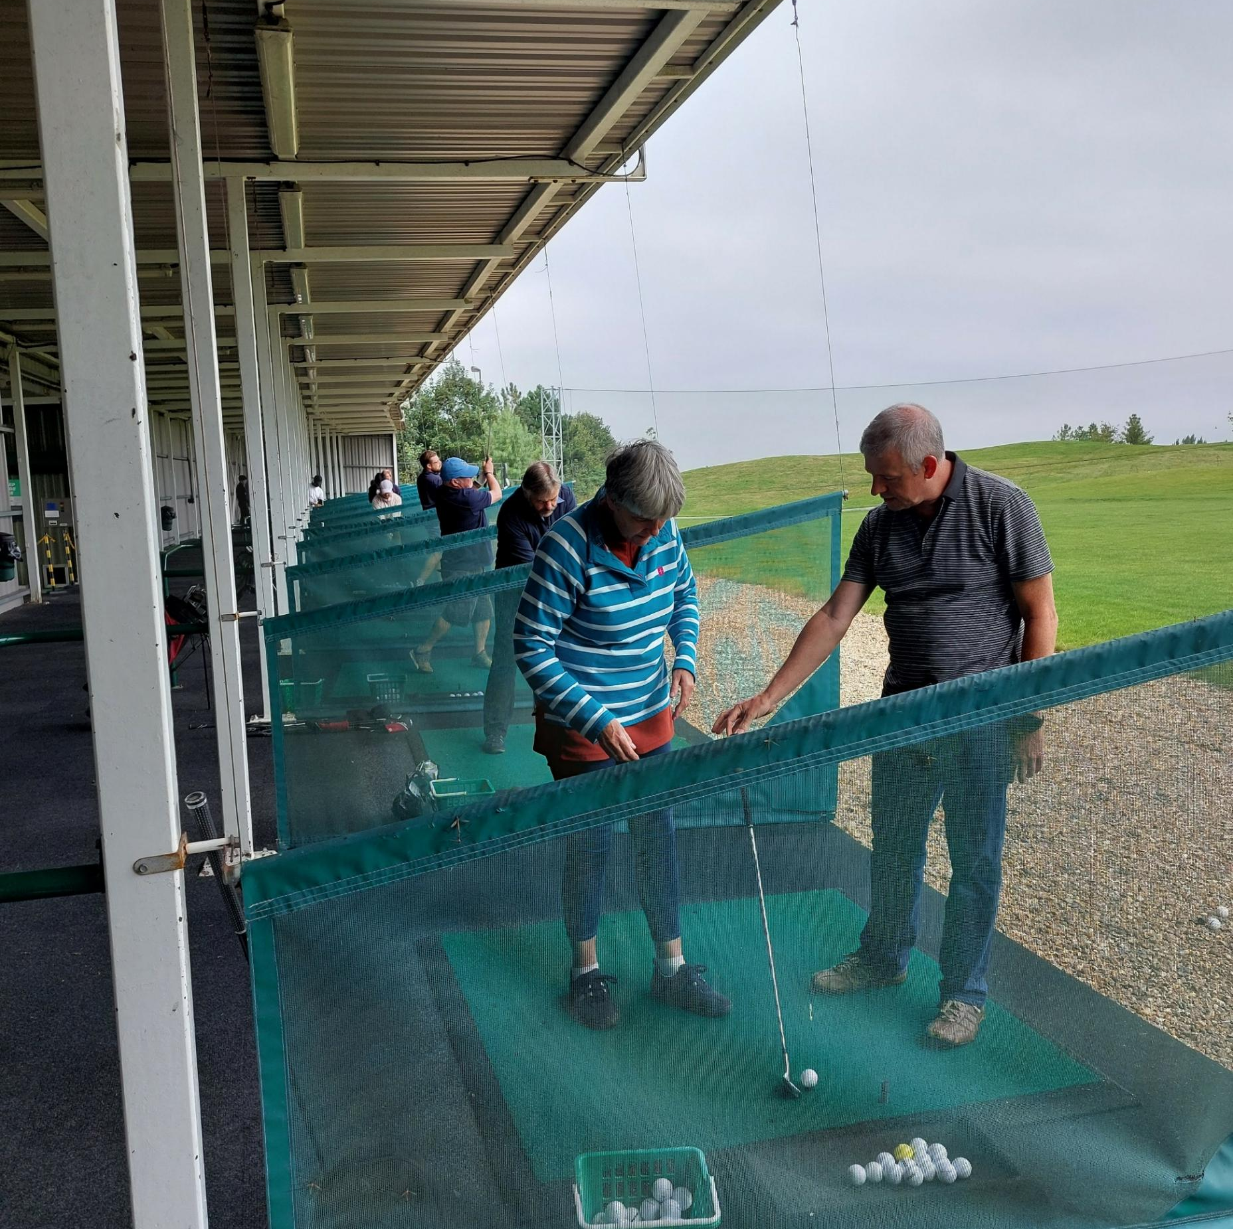
GOLF FOR ALL
Weekly golf sessions at the West London golf centre.
20 participants
Activities and a chat.
Reliving and creating memories
Partnership with the Golf Trust.

Slide 9
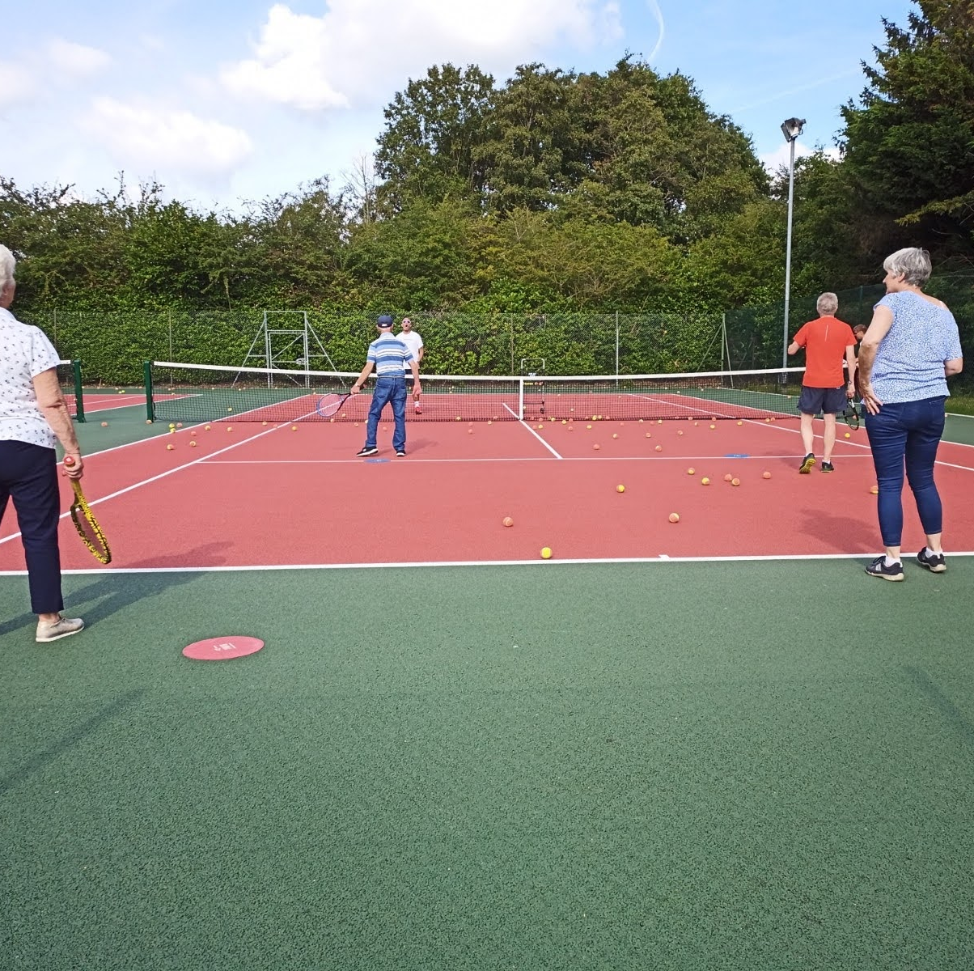
TENNIS
Uxbridge Tennis Club
Weekly fun activities.
LBH
LTA

Slide 10
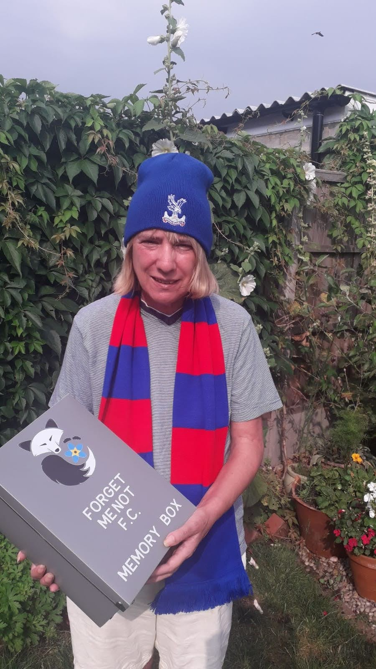
KEEPING CONNECTED
MEMORY BOXES
DOORSTEP VISITS
ZOOM SESSIONS
WEEKLY NEWSLETTER
BUDDY TELEPHONE CALLS
OUTDOOR BOCCIA CLUB

Slide 11
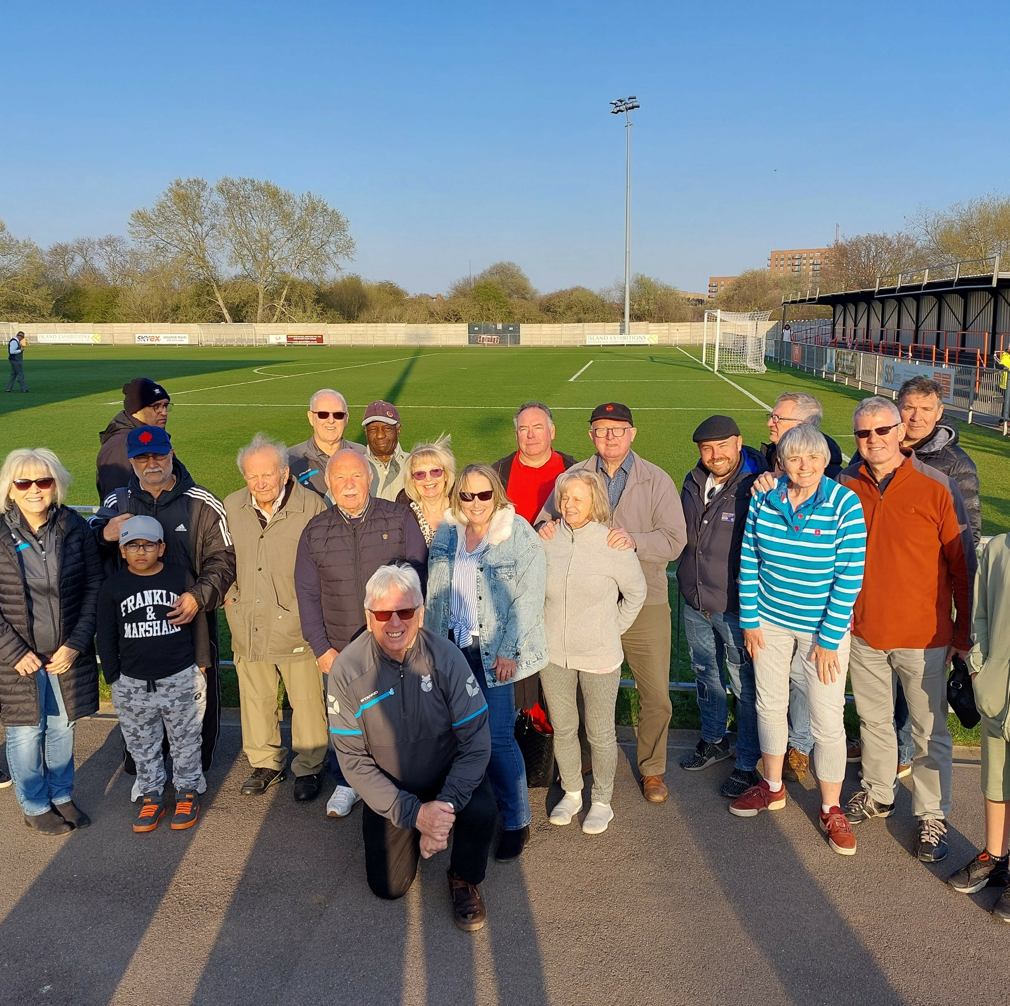
The Matchday Experience
Once a season dementia friendly match at multiple clubs.
Enjoy the atmosphere, the sport and reminisce with friends.
Fundraising and partner donors.
Hayes and Yeading FC.
QPR.

Slide 12
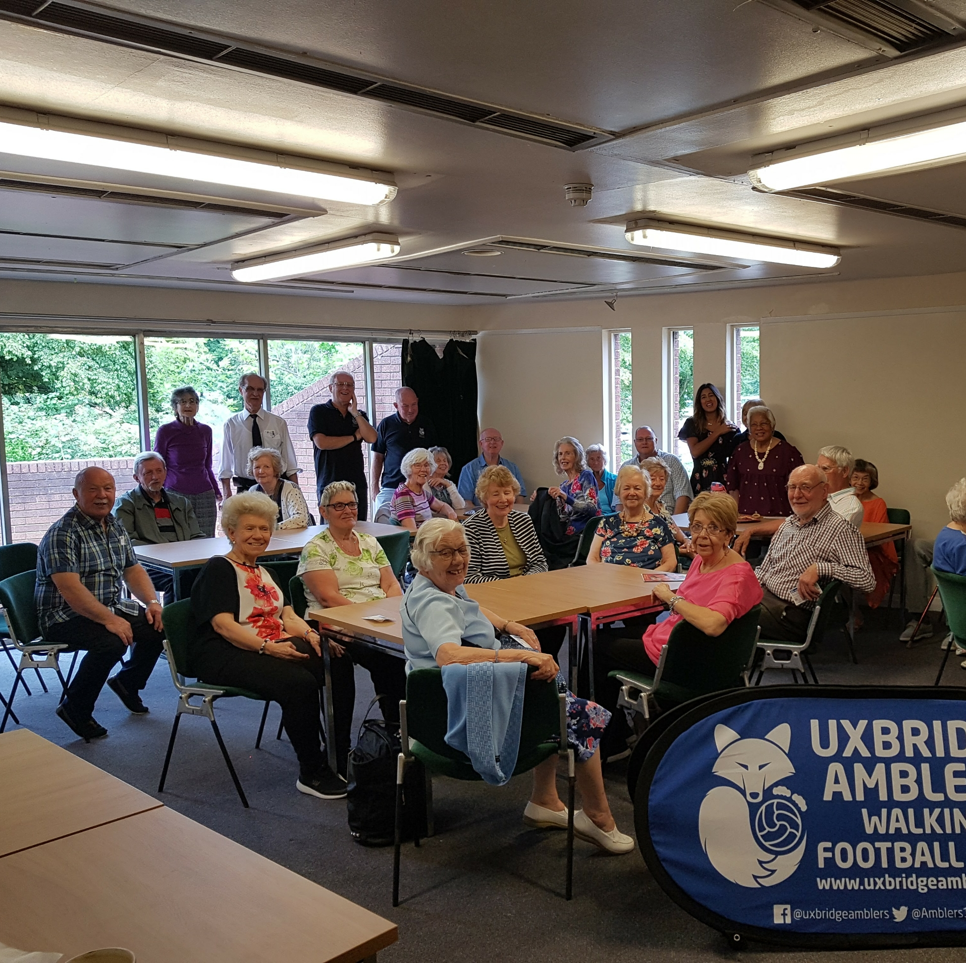
The Stars of Stage and Screen
Beck Theatre Dementia Friendly screenings.
Tickets to the Summer and Christmas Memories shows.
LBH partnership.

Slide 13
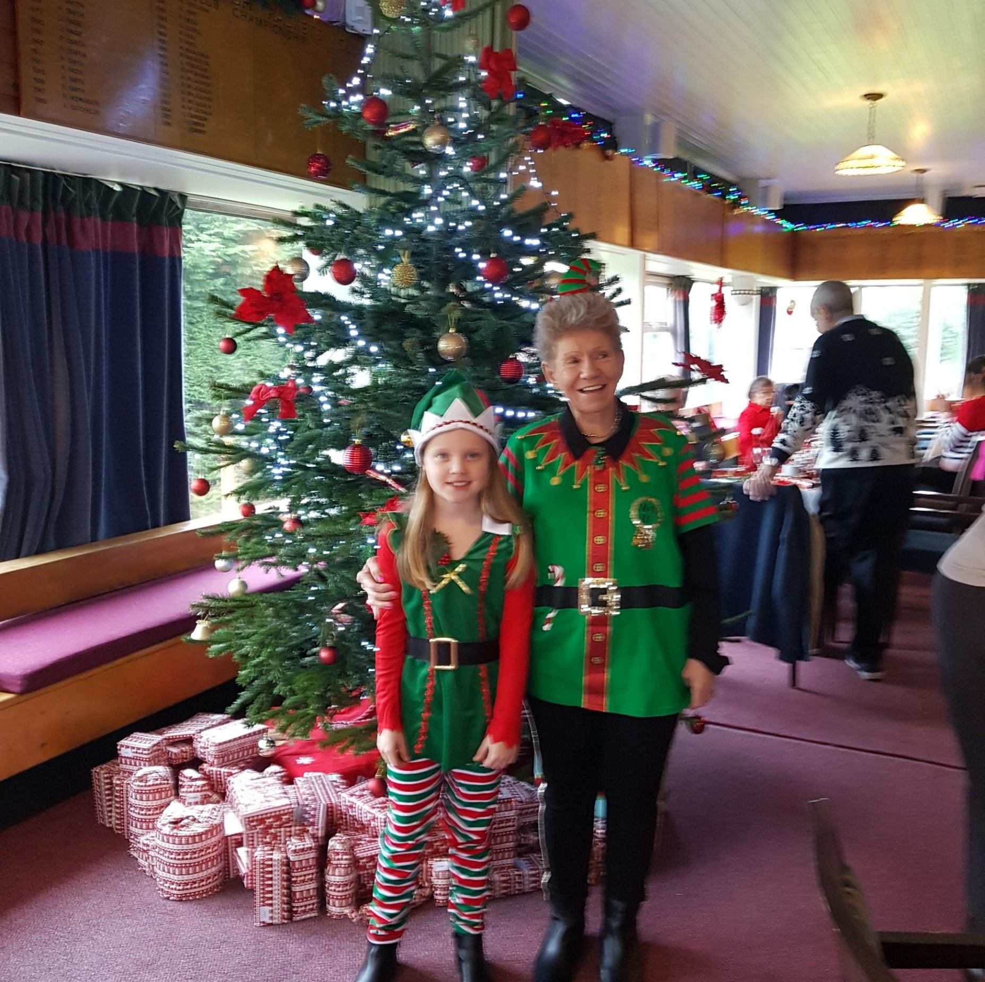
CHRISTMAS CELEBRATIONS
70 guests from Dementia Friends Hillingdon.
2 course lunch
Entertainment and gifts.
Fundraising.
Uxbridge Sports Club.
Wenzels.

Slide 14
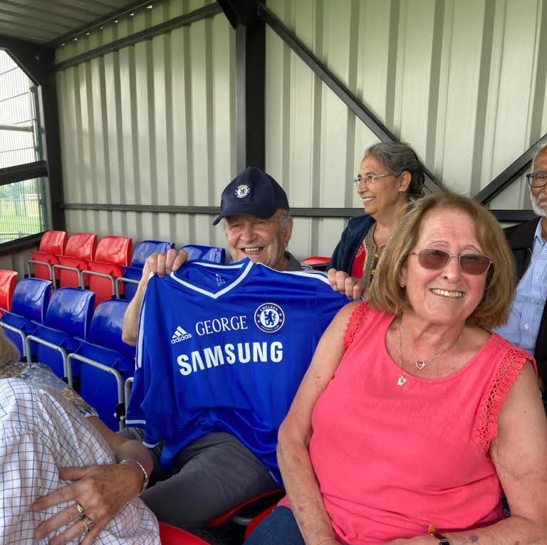
WHY WE DO WHAT WE DO
To continue to make the London Borough of Hillingdon the leading Dementia Friendly Community in the Capital.
Create new friendships and put a smile into peoples lives.
“Always remember there is more to the person than dementia “

Slide 15
THE STORY CONTINUES........
GOLD AWARD WINNERS
FOR HELPING VULNERABLE PEOPLE

